Slide 1
MENTAL HEALTH DETECTION USING MACHINE LEARNING

Slide 2
CONTENT
Abstract
Introduction
Existing system
Disadvantages
Problem statement
Proposed system
Advantages
System requirement specifications
1. S/W & H/W
2. Functional & Non-Functional
SYSTEM DESIGN-ARCHITECTURE
ALGORITHM
.MODULES
DATA FLOW DIAGRAM/UML DIAGRAMS
Conclusion

Slide 3
ABSTRACT
Early detection of mental health issues allows specialists to treat them more effectively and it improves patient’s quality of life.
Mental health is about one’s psychological, emotional, and social well-being. It affects the way how one thinks, feels, and acts.
Mental health is very important at every stage of life, from childhood and adolescence through adulthood.
This study identified five machine learning techniques and assessed their accuracy in identifying mental health issues using several accuracy criteria.

Slide 4
INTRODUCTION
A person’s mental well-being is his or her mental condition, as well as an overview of his or her general environment. Brain chemistry abnormalities are the cause of mental illness.
An individual’s mental health serves as a barometer for properly addressing his or her diseases.
To predict any health-related irregularities, it is critical to keep track of diverse groups’ mental health profiles.
The community is made up of working professionals, college students, and high school students.

Slide 5
EXISTING SYSTEM
There has been many studies and researches where people have been predicting mental health problems like depression and anxiety using the algorithms of machine learning.
Majorly decision tree, support vector machine, random forest and convolution neural network for the collection and classification of data from blog posts.

Slide 6
DISADVANTAGES
Less number if samples data considered to take as the dataset for operation
It produces less accuracy when compare to the proposed system.
among all the models SVM came out to have the best accuracy of 91.634 percent and the f measure score was 92.13.

Slide 7
PROBLEM STATEMENT
The Mental Health Issue theory contends that issues start in childhood and continue through adolescence and adulthood.
This study, motivated by the growing use of machine learning techniques in the research aspects of medical diagnosis, aims to examine the possible application of several algorithms for predicting and analyzing Mental Health Issue difficulties in kids, teens, and adults.

Slide 8
PROPOSED SYSTEM
The initial step is data collection.
We have tried to collect data from different places. There was no standard dataset available which could match our requirements. Hence, we had to collect all the data ourselves.
We made a survey form for each disease and distributed, both online and offline for people to fill it.
The nature of our questions was objective and situational.
We also included people who are currently suffering from some kind of mental illness and are seeing doctors for it and taking some kind of medications.

Slide 9
PROPOSED SYSTEM
Once the data collection is done, the user's response is converted using numeric values of 0 to 3, and in some cases 0 to 4.
Once we had enough data collected, it was moved to preprocessing and is split into two subsets i.e., training and test data sets.
It is important to fill out the missing values in the dataset or modify it to increase the quality of the dataset.
Once the preprocessing of data is completed, it then moved to feature extraction thenceforth prediction of mental illness.

Slide 10
ADVANTAGES
For the Mental Health Disorder Screening in Data for Adult, Children, and Adolescents, respectively, CNN-based prediction models perform better with higher accuracy.
These findings strongly show that a CNN-based model, as opposed to the other typical machine learning classifier recommended in other studies, can be used to detect Mental Health Disorder .

Slide 11
SYSTEM REQUIREMENT SPECIFICATIONS
Hardware Requirements
1)Operating System : Windows Only
2)Processor : i3 and above
3)Ram : 4gb and above
4)Hard Disk : 50 GB
Software Requirement
1)Visual Studio Community Version or Anaconda Navigator
2)Python IDEL ( Python 3.7 )
Language – Python, HTML

Slide 12
FUNCTIONAL REQUIREMENTS
Functional requirements are represented or stated in the form of input to be given to the system, the operation performed and the output expected. System should collect the data from any resources. All the collected data should be processed for proper use, some analysis should be done for understanding the data properly.
Upload ASD dataset
Data Preprocessing
Model Generation
Build LR,KNN,SVM,NB,ANN & CNN Classifiers
Upload Test Data
Detect Autism

Slide 13
NON-FUNCTIONAL REQUIREMENTS
Usability
Usability is the main non-functional requirement for the “Analysis and Detection of Autism Spectrum Disorder using Machine Learning Techniques and deep learning”. The UI should be simple enough for everyone to understand and get the relevant information without any special training. Different languages can be provided based on the requirements.
Accuracy
Accuracy is another important non-functional requirement for the “Analysis and Detection of Autism Spectrum Disorder using Machine Learning Techniques and deep learning”. The dataset is used to Train and Test Model in python .Prediction should be correct, consistent, and reliable.
Availability
The System should be available for the duration when the user operates and must be recovered within an hour or less if it fails. The system should respond to the requests within two seconds or less.
Maintainability
The software should be easily maintainable and adding new features and making changes to the software must be as simple as possible. In addition to this, the software must also be portable.

Slide 14
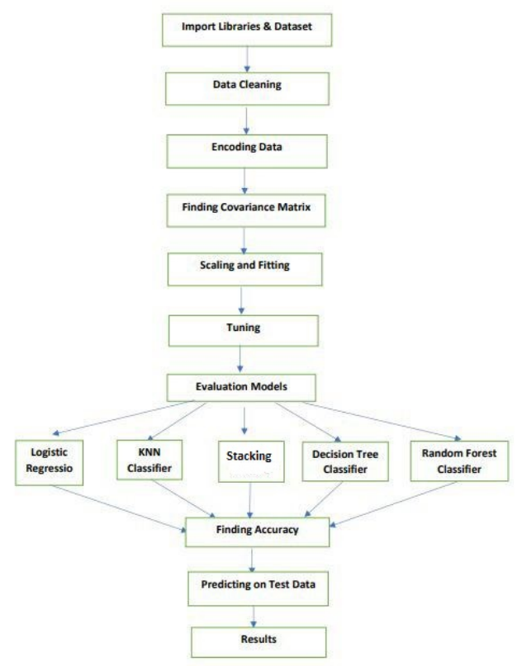
SYSTEM DESIGN ARCHITECTURE

Slide 15
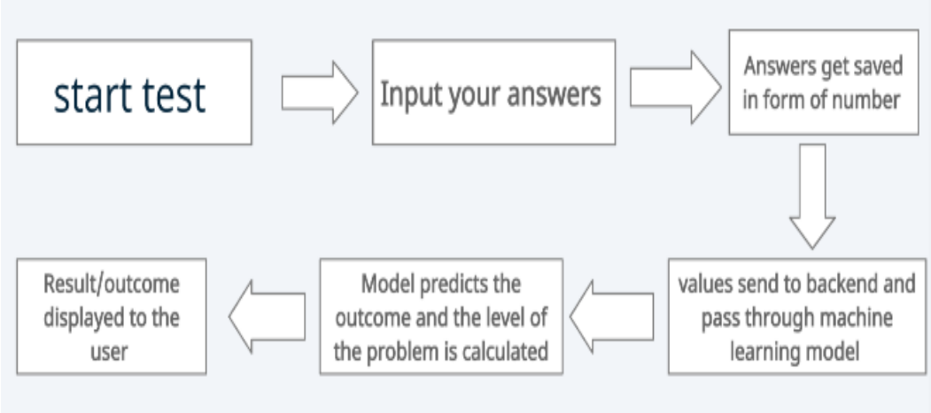
SYSTEM WORKFLOW

Slide 16
ALGORITHMS
Logistic Regression: Logistic regression is a Machine Learning classification algorithm that is used to predict the probability of certain classes based on some dependent variables
SVM: Support Vector Machine or SVM is one of the most popular Supervised Learning algorithms, which is used for Classification as well as Regression problems.
Naïve Bayes : Naïve Bayes algorithm is a supervised learning algorithm, which is based on Bayes theorem and used for solving classification problems.
KNN: K-NN algorithm stores all the available data and classifies a new data point based on the similarity.
ANN : Artificial Neural Network(ANN) uses the processing of the brain as a basis to develop algorithms that can be used to model complex patterns and prediction problems.
CNN
Xgboost:
Adaboost:
Random Forest:
Decision Tree:
ensemble Naïve Bayes, Adaboost and Xgboost, RNN and GAN,

Slide 17
ALGORITHMS
CNN : A CNN is a kind of network architecture for deep learning algorithms and is specifically used for image recognition and tasks that involve the processing of pixel data.
Xgboost: XGBoost is a scalable and highly accurate implementation of gradient boosting that pushes the limits of computing power for boosted tree algorithms, being built largely for energizing machine learning model performance and computational speed.
Adaboost: AdaBoost Algorithm is also known as Adaptive Boosting is an Ensemble modelling technique used in Machine Learning to find the best model.
Random Forest: Random Forest is a popular machine learning algorithm that belongs to the supervised learning technique.
Decision Tree: A decision tree is a very specific type of probability tree that enables you to make a decision about some kind of process.
ensemble Naïve Bayes, Adaboost and Xgboost, RNN and GAN,

Slide 18
MODULES
Data exploration: using this module we will load data into system
Processing: Using the module we will read data for processing
Splitting data into train & test: using this module data will be divided into train & test
Model generation: Logistic Regression, SVM, Naïve Bayes , KNN, ANN and CNN
EXTENSION: Xgboost, Adaboost, Random Forest and Decision Tree, ensemble Naïve Bayes, Adaboost and Xgboost, RNN and GAN, Algorithms accuracy calculated.
User signup & login: Using this module will get registration and login
User input: Using this module will give input for prediction
Prediction: final predicted displayed

Slide 19
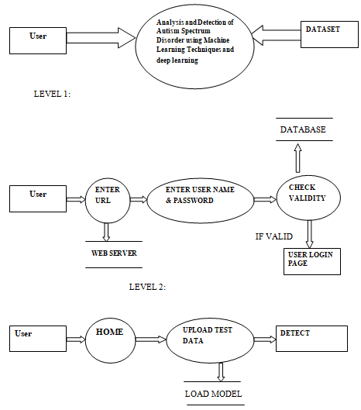
DATAFLOW DIAGRAM

Slide 20
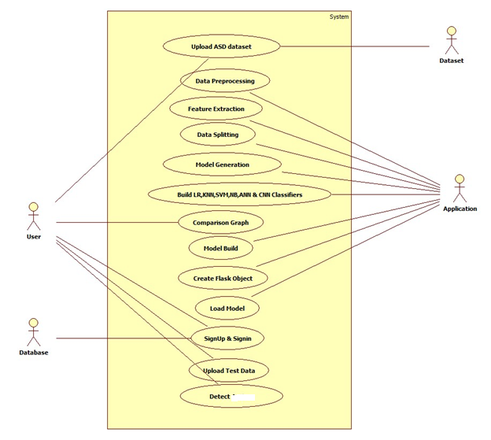
USECASE DIAGRAM

Slide 21
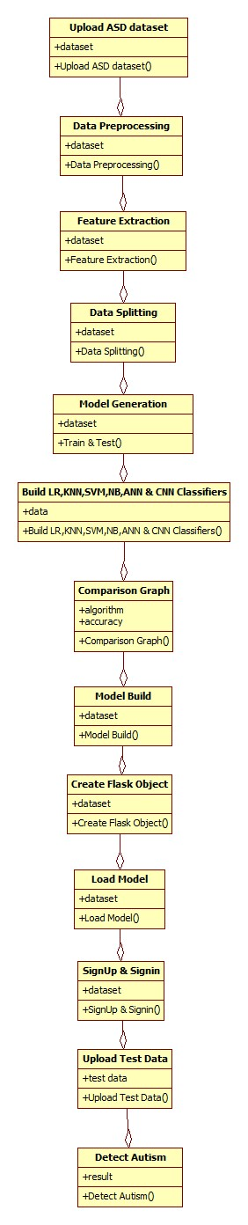
CLASS DIAGRAM

Slide 22
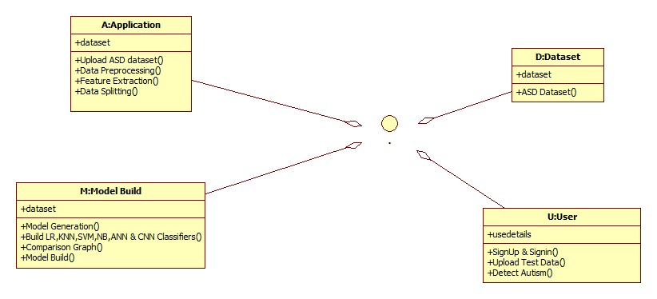
OBJECT DIAGRAM

Slide 23
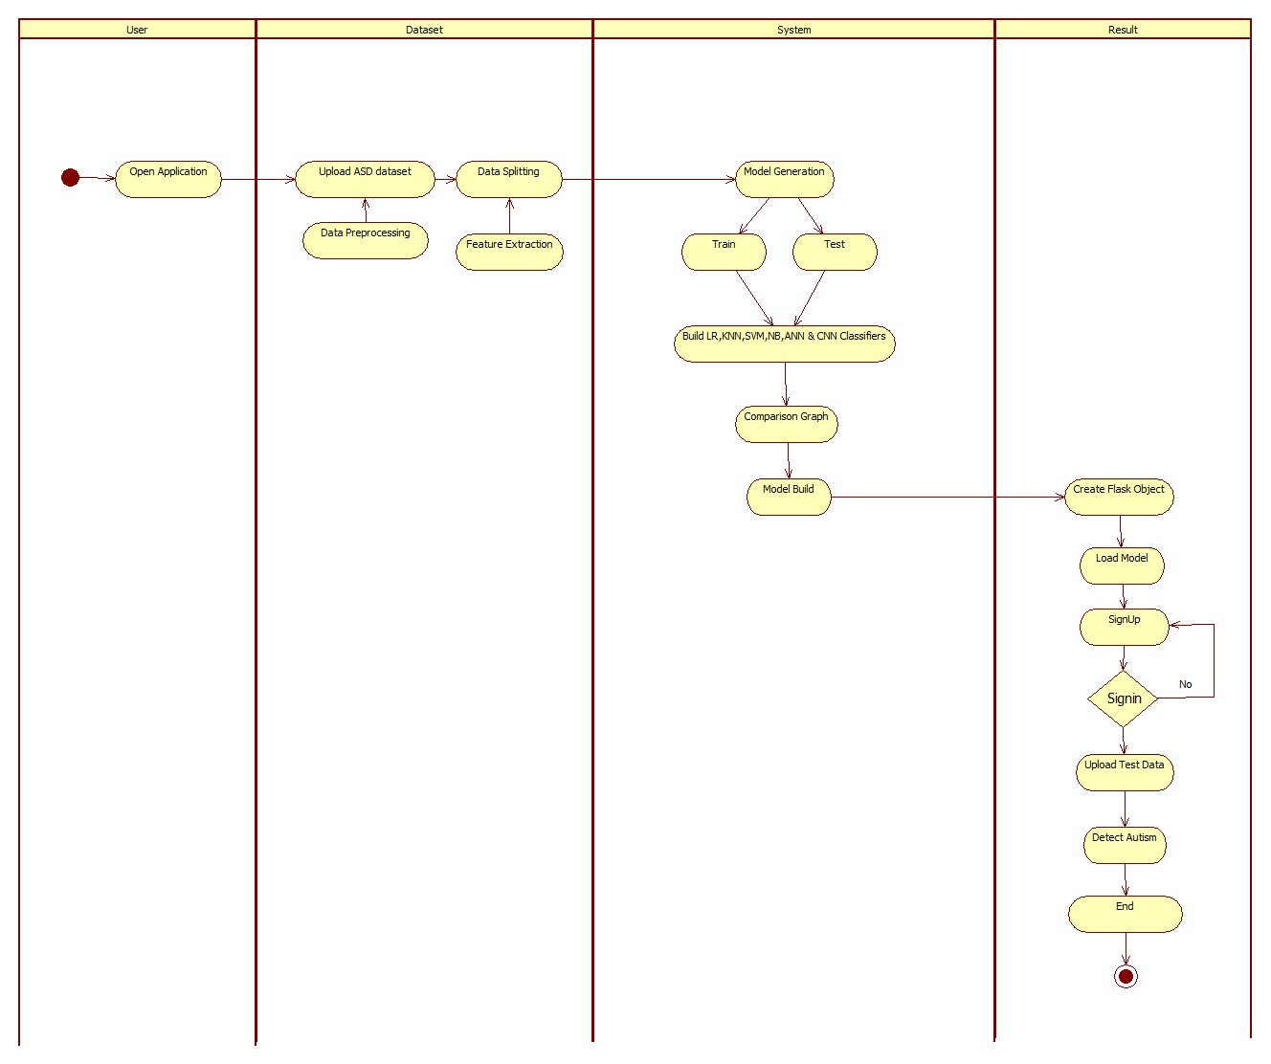
ACTIVITY DIAGRAM

Slide 24
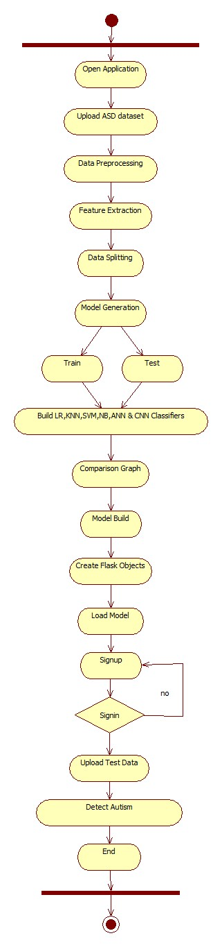
STATE DIAGRAM

Slide 25
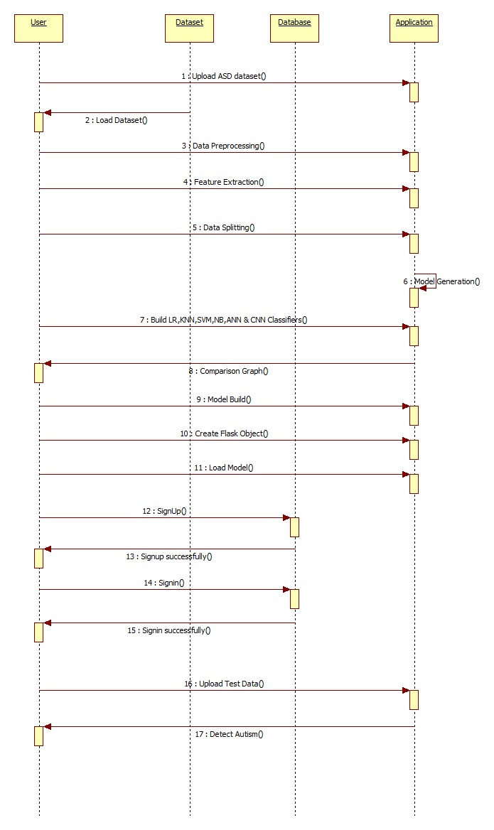
SEQUENCE DIAGRAM

Slide 26
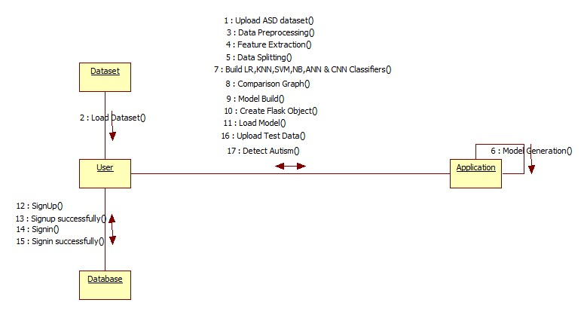
COLLABORATION DIAGRAM

Slide 27
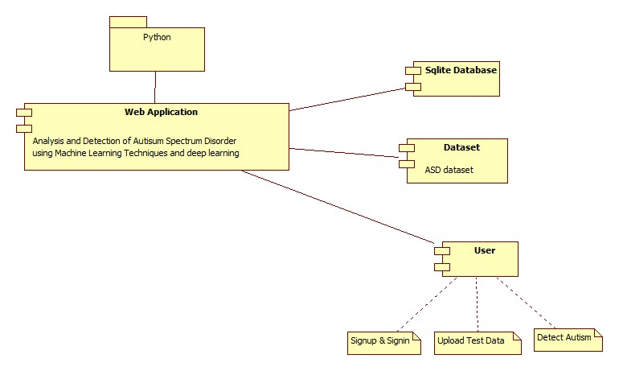
COMPONENT DIAGRAM

Slide 28
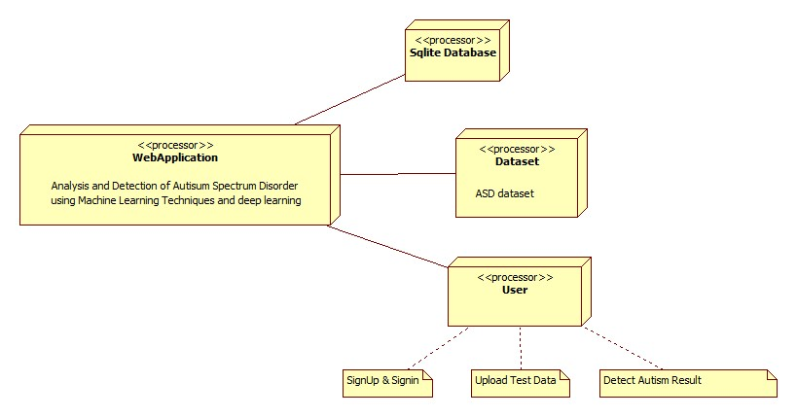
DEPLOYMENT DIAGRAM

Slide 29
EXTENSION
1) In this paper the author had applied Logistic Regression (accuracy is 96), SVM (accuracy is 98), Naïve Bayes (accuracy is 96), KNN (accuracy is 95), ANN (accuracy is 97) and CNN (accuracy is 99). So as an extension we will apply some other algorithms like Xgboost, Adaboost, Random Forest and Decision Tree.
2) As an extension we will ensemble Naïve Bayes, Adaboost and Xgboost.
3) As an extension we will apply some other deep learning techniques like RNN and GAN
4) For this project we will implement Front end using Flask Framework as an extension.5) We will provide user authentication using sqlite3 database.

Slide 30
CONCLUSION
In this study, multiple machine learning and deep learning approaches were used to try and detect Mental Stress Detection.
The effectiveness of the models employed for Mental illness identification on non-clinical datasets from three sets of age groups, namely children, adolescents, and adults, was examined using a variety of performance evaluation measures.
We believe we were able to achieve a good accuracy for each of the four diseases.
furthermore, in future we can add more disease and combine multiple method along with questionnaire to make this process more robust and stronger.

Slide 31
REFERENCE
[1] Sau, A., Bhakta, I. (2017)"Predicting anxiety and depression in elderly patients using machine learning technology. “Healthcare Technology Letters 4 (6): 238-43.
[2] Tyshchenko, Y. (2018)"Depression and anxiety detection from blog posts data."Nature Precis. Sci., Inst. Comput. Sci., Univ. Tartu, Tartu, Estonia.
[3] R.A.Calvo and S. D’Mello. Affect detection: An interdisciplinary review of models, methods, and their applications. IEEE Trans. Affective. Comput., 1(1):18-37, 2010.
[4] Q. Zhang, Q. Wu, H. Zu, L. He, H. Huang, J. Zhang and W. Zhang. Multimodal MRI-Based Classification of Trauma Survivors with and without Post-Traumatic Stress Disorder. Frontiers in Neuroscience, 2016.
[5] X. Zhuang, V. Rozgic, M. Crystal and B. P. Marx. Improving Speech Based PTSD Detection via MultiView Learning. IEEE Spoken Language Technology Workshop. 260-265, 2014.

